Slide 1
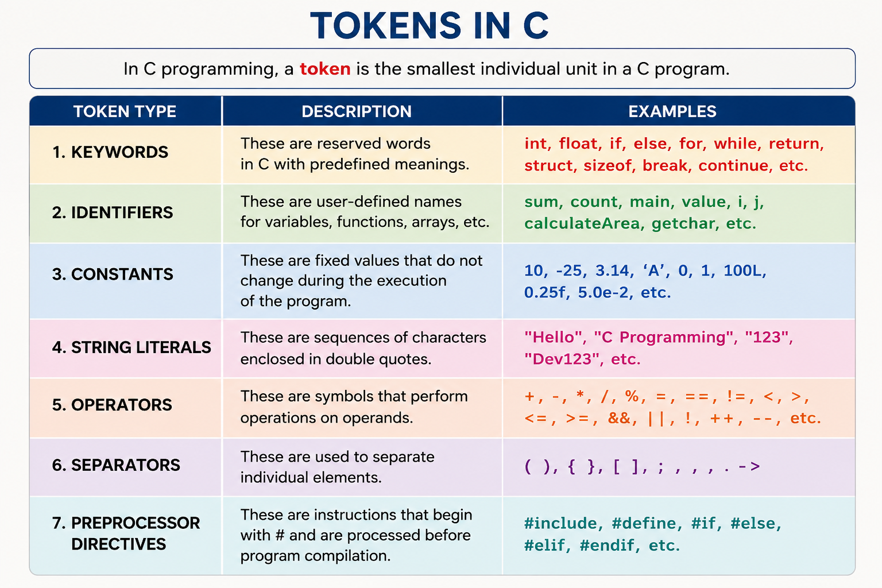

Slide 2
Keywords
These are some reserved words in C which have predefined meaning to compiler called keywords.
Keywords are not to be used as variable and constant names.
All keywords have fixed meanings and these meanings cannot be changed.

Slide 3
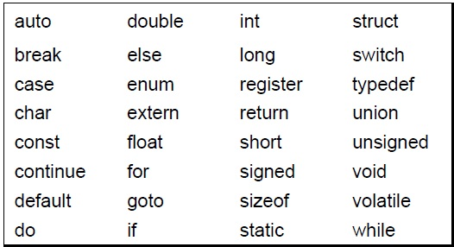
Compiler specific keywords
Some commonly used keywords are given below:

Slide 4
Constants
Constants are data values that cannot be changed during the execution of a program.

Slide 5
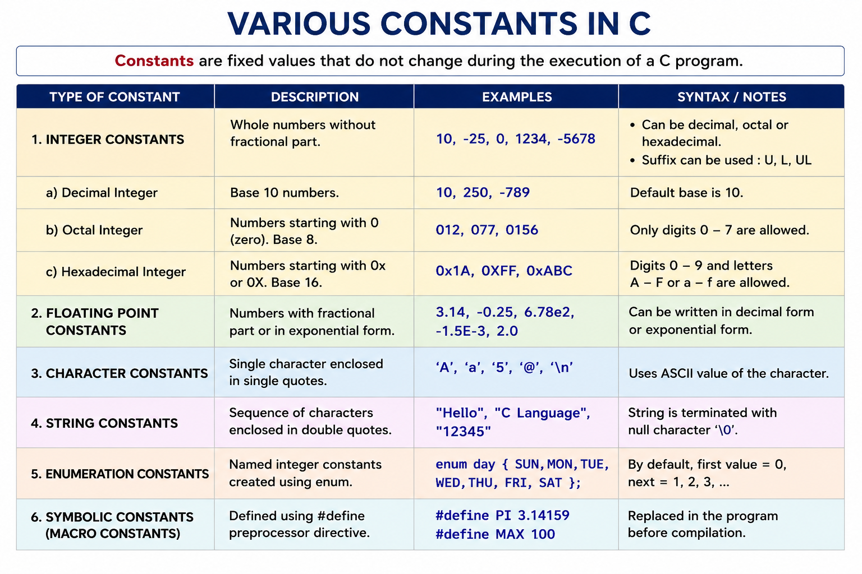

Slide 6
Enumeration
Enumeration (enum) in C Programming
#include <stdio.h>
enum Day { SUN, MON, TUE, WED, THU, FRI, SAT};
int main()
{
enum Day today = WED;
printf("%d", today);
return 0;
}
enum is used to create symbolic names for a set of integer constants.
enum NewDataType
{
Symbolic constant1,
Symbolic constant2,
Symbolic constant3
};
The first enumerator starts from 0, and the remaining values increase by 1.

Slide 7
#include <stdio.h>
enum Traffic
{
RED,
YELLOW,
GREEN
};
int main()
{
enum Traffic signal = GREEN;
if(signal == GREEN)
printf("Go");
else
printf("Stop");
}
enum Number
{
A = 5,
B,
C = 10,
D,
E
};

Slide 8
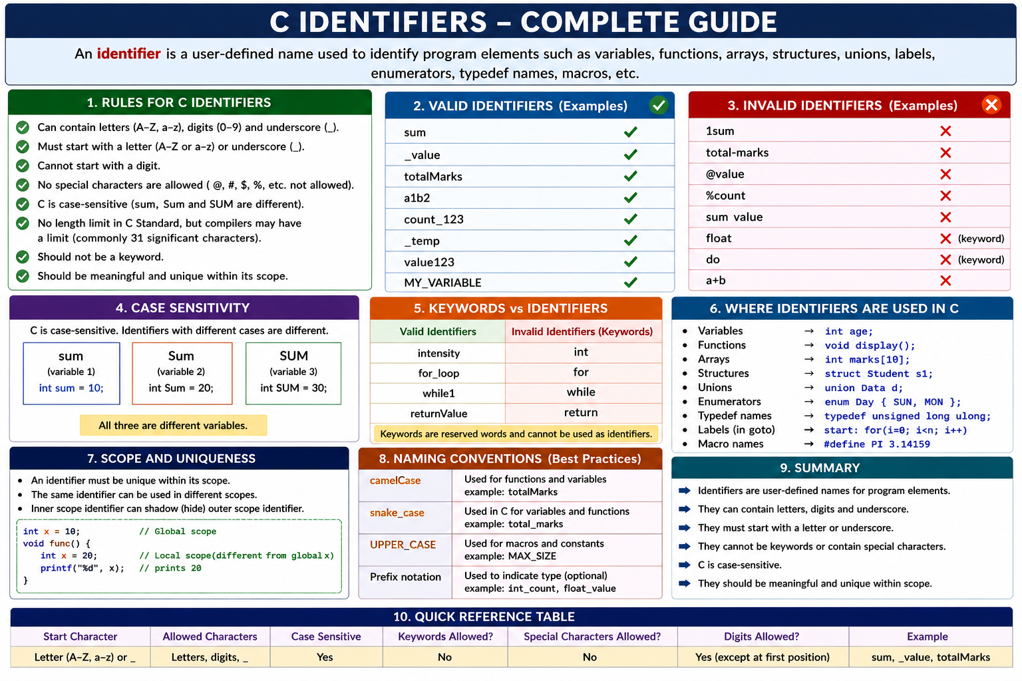

Slide 9
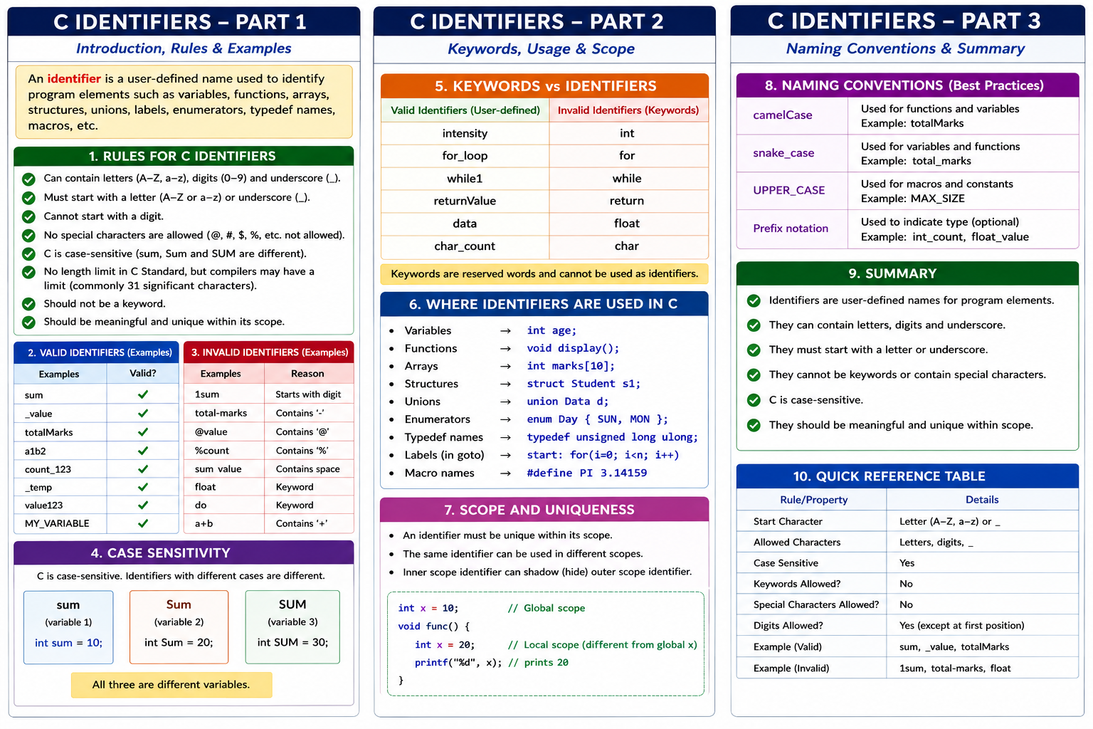

Slide 12
Definition of a Variable:
A variable in C is a named memory location used to store data that can be modified during the execution of a program.

Slide 13
Key Concepts of Variables
1. Declaration of Variables
Before using a variable in C, you must declare it by specifying:
Data Type: The type of data the variable will store.
Variable Name: A name to reference the variable.

Slide 14
int age; // Declares an integer variable
float salary; // Declares a floating-point variable
char grade; // Declares a character variable

Slide 15
Primary (built-in or Basic)Data types
INTEGER
CHARACTER
SIGNED TYPE UNSIGNED TYPE
INT UNSIGNED INT
SHORT INT UNSIGNED SHORT INT
LONG INT UNSIGNED LONG INT
SIGNED CHARACTER
UNSIGNED CHARACTER
FLOATING POINT
VOID
FLOATING POINT TYPE
FLOAT
DOUBLE
LONG DOUBLE
VOID

